Slide 1
AI Smart Customer Support
Group Members
1)Swarupanand Bajbalkar
2)Samruddhi Shingade
3) Rutuja Puranik
4)Mrudula Waghmode

Slide 2
Problem Statement
• Traditional customer support systems are slow and heavily dependent on manual effort
Most organizations still rely on support agents to read, understand, and respond to every query manually.
This leads to delays, especially when the number of customer requests increases.
• Delayed responses result in poor customer satisfaction and frustration
When users do not receive immediate assistance, they become dissatisfied.
Slow response times directly affect customer experience and lower the overall service quality.
• No automatic ticket categorization or intelligent routing
Support tickets are often categorized manually by agents, which is time-consuming and error-prone. Without automated classification, tickets do not reach the right team quickly, causing further delays.
• Lack of sentiment detection means frustrated or angry customers go unnoticed
Support systems do not analyze the customer’s emotional tone.
As a result, critical or high-priority negative messages are treated the same as normal ones,
leading to unresolved frustration and poor user retention.

Slide 3
Project Overview
• AI chatbot for instant customer support
The system includes an intelligent chatbot capable of understanding user queries and providing immediate responses. It reduces the need for human intervention for common issues and improves overall response speed.
• Automatic ticket creation for unresolved or complex issues
If the chatbot cannot fully answer or solve a query, the system automatically generates a support ticket. This ensures that every user concern is tracked, documented, and forwarded to the admin for review.
• Sentiment and intent detection using NLP techniques
The platform uses Natural Language Processing (NLP) models to analyze user messages.
It can detect the user’s emotional tone (positive, neutral, negative) and understand their intent
(e.g., technical issue, billing query, complaint).
This helps in prioritizing and accurately categorizing support requests.
• Feature-rich admin panel with detailed analytics and visual reports
Admins can view ticket statistics, sentiment trends, category breakdowns, and pending vs resolved issues. This dashboard helps administrators make informed decisions and improve support performance.
• Secure login and authentication using JWT (JSON Web Token)
The system uses industry-standard JWT authentication to ensure that only authorized users and admins can access the platform. This provides secure session management, improves data protection, and prevents unauthorized access.

Slide 4
Technology Stack
1. React Frontend (UI Layer)
Working:
Shows all screens: Login, Chatbot, Tickets, Dashboard
Sends/receives data via API (Axios/Fetch)
Displays chatbot replies, ticket status & analytics
Why: Fast UI, real-time interaction, smooth API integration
2. .NET Core Backend API (Main Logic Layer)
Working:
Handles all business logic
Validates users via JWT
Manages tickets, users, analytics
Communicates with SQL Server, MongoDB & AI service
Why: Secure, fast, scalable, industry-standard
3. SQL Server (Authentication DB)
Stores: Users, Password Hash, Role (User/Admin)
Why:
Best for structured relational data
Highly secure login system

Slide 5
Technology Stack
4. MongoDB (Tickets + Chat DB)
Stores: Tickets, chat logs, sentiment, classifications
Why:
Flexible schema
Fast read/write
Perfect for unstructured support data
5. Node.js AI Microservice (ML/NLP Engine)
Working:
Receives messages from backend
Predicts sentiment, intent, category
Generates chatbot replies
Why:
Runs AI separately → better performance
Easy to upgrade ML models
6. Chatbot Engine (Rule-based + AI)
Working:
Answers common queries using predefined rules
Uses AI for advanced replies
Creates tickets when unable to answer
Example:
User: “I am frustrated.”
Bot: “I’m sorry for the trouble, creating a ticket now.”

Slide 6
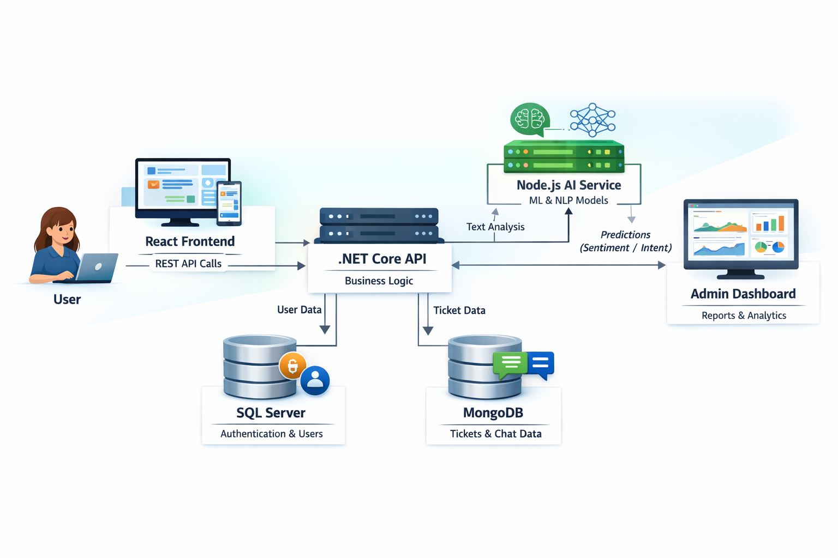
System Architecture

Slide 7
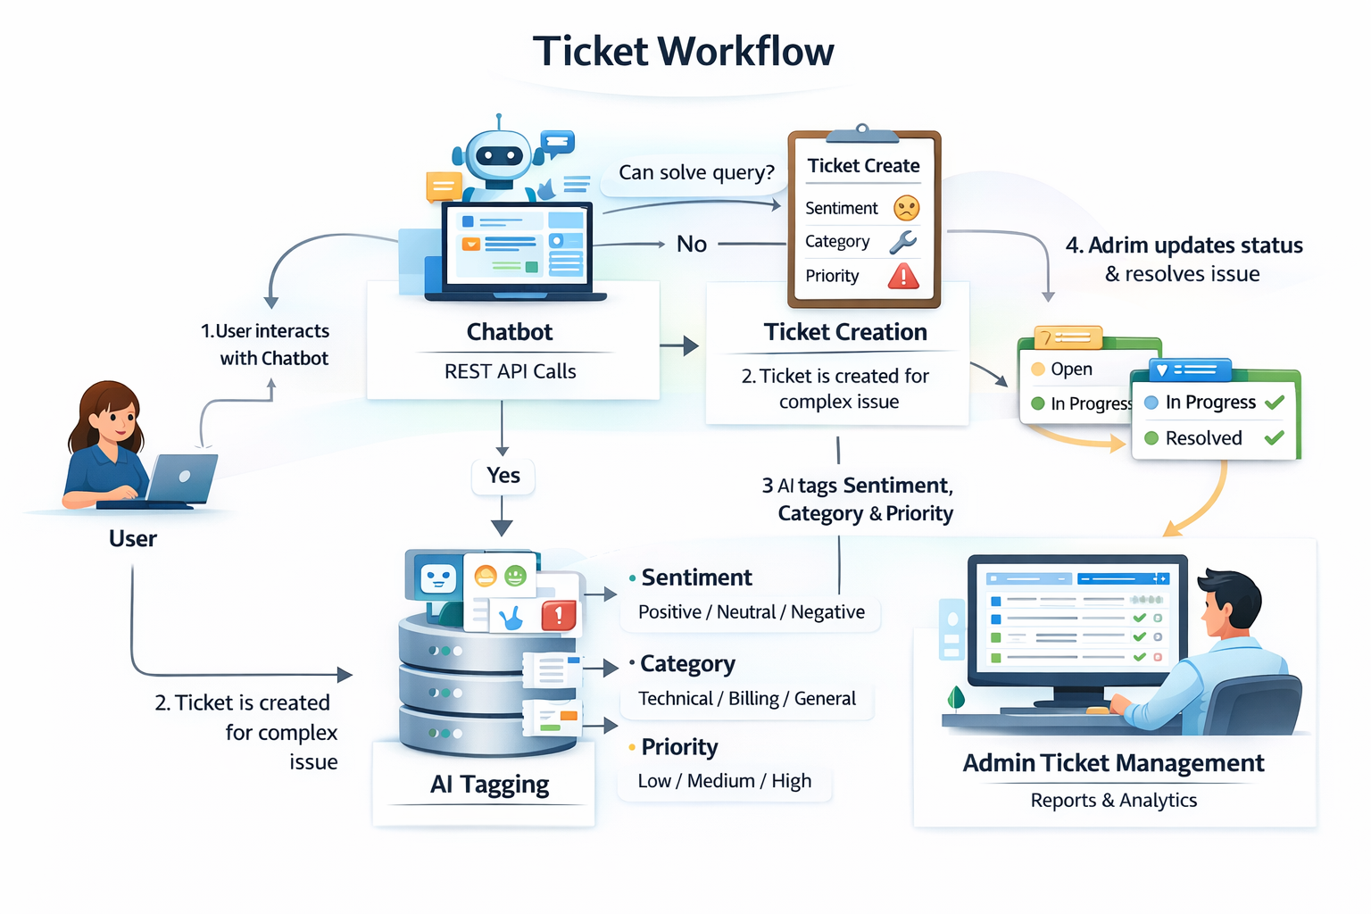
Ticket Workflow

Slide 8
AI Components
Sentiment Analysis (Positive / Neutral / Negative)
This model understands the customer’s emotion from their message.
It detects whether the user is happy, normal, or frustrated so the system can prioritize urgent issues.
Intent Classification (Technical / Billing / etc.)
This identifies the purpose of the user’s message.
For example, whether they are asking about a technical problem, billing issue, login trouble, or a general query.
Ticket Category Prediction
When a ticket is created, the AI automatically assigns it to the correct category.
This helps route the ticket to the right support team without manual sorting.
Priority Prediction (Low / Medium / High)
The AI decides how urgent a ticket is based on the user’s message.
High-priority issues (angry tone, system failure) get immediate attention.

Slide 9
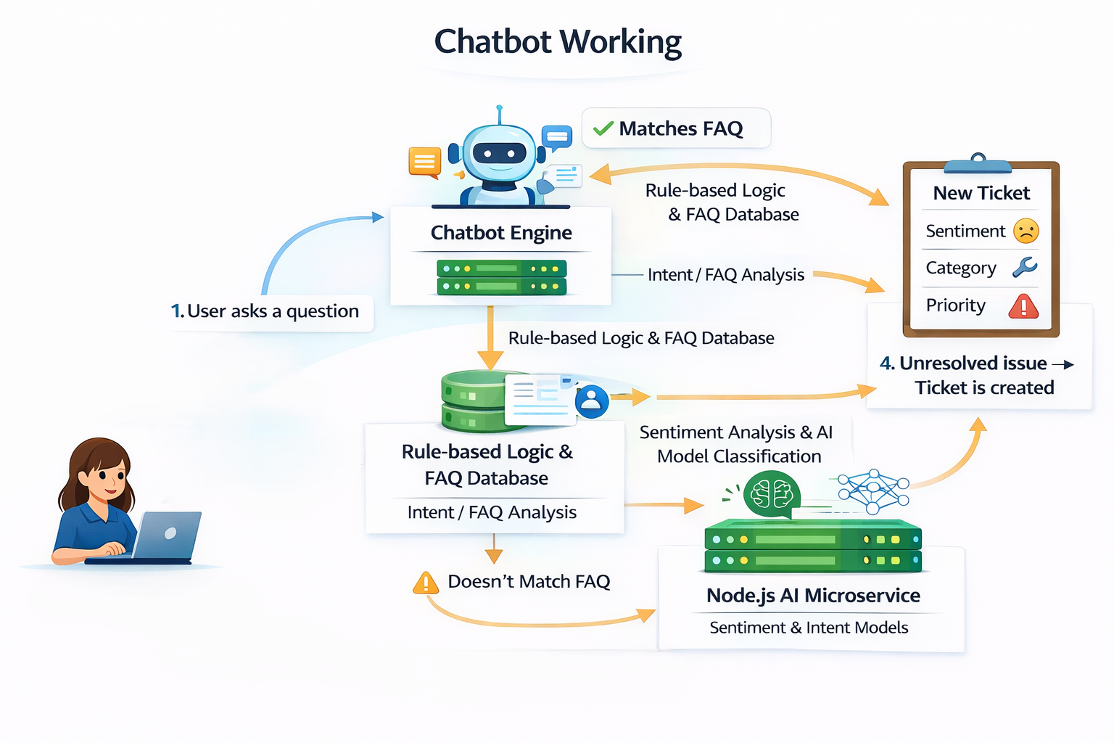
Chatbot Working
Chatbot Working (Bullet Points)
Uses rule-based logic to answer common FAQ queries instantly.
If the question matches a known pattern, it responds immediately.
If the message is unclear, it sends it to the AI model for better understanding.
AI analyzes the message for intent and sentiment.
If the issue still cannot be resolved, the chatbot automatically creates a support ticket.
Ticket is forwarded to the admin for manual resolution.

Slide 10
Datasets Used
1)Sentiment Analysis Dataset
Used for detecting whether the customer is Positive / Negative / Neutral.
Best Options (Short List)
Twitter Sentiment Dataset (Kaggle)
Amazon Reviews Dataset (Kaggle)
Why We Use It
Text format is similar to customer complaints
Already labeled → easy to train
Works well with simple ML models like Logistic Regression / Naive Bayes
2)Ticket Classification Dataset
Used for predicting ticket type:
🔹 Technical Issue
🔹 Billing Issue
🔹 Account/ Login Issue
🔹 General Query
Best Options
Customer Support Ticket Classification (Kaggle)
IT Helpdesk Ticket Dataset (Kaggle)
Why We Use It
Contains real helpdesk queries
Clean and easy text
Perfect fit for our AI classification module

Slide 11
Datasets Used
Priority Prediction Dataset
Used to predict Low / Medium / High priority.
Best Options
IT Ticket Severity Dataset (Kaggle)
Custom Mini Dataset (100–150 labeled samples)
Why Custom Dataset Works
Priority is subjective → small datasets work
Simple ML models don’t need huge data
Faculty prefers student-created datasets

Slide 12
Future Scope Implemented
Priority Prediction Model
A small machine learning model (Naive Bayes / Logistic Regression) can be added to automatically predict ticket priority such as Low, Medium, or High based on text.
Improved Sentiment Analysis
The existing rule-based approach can be upgraded using lightweight pretrained models such as VADER or TextBlob to improve accuracy in emotion detection.
Intent Classification for Chatbot
An intent classifier can be implemented to categorize user messages into types such as General Query, Billing Issue, Technical Issue, and Complaint.
Admin Analytics Additions
Additional analytics such as sentiment distribution, ticket trends, and category-based charts can be implemented using Chart.js.
Email Notification System
A simple email alert feature can be added to notify users about ticket creation and status updates.

Slide 13
References
[1] C. S. Kanimozhi Selvi, S. J. Shri, R. Prasshanthini, N. Neelamegan and R. Sanjay, “Customer Support Ticket Categorization and Prioritization Using Natural Language Processing,” in Proc. 3rd Int. Conf. Futuristic Technology (INCOFT), 2025. :contentReference[oaicite:7]{index=7}
[2] R. Jayadi, “Sentiment Analysis of Digital Customer Service Helpdesk Tickets: A Comparison between BERT and SVM,” Proc. 2024 Int. Conf. Computer Eng., Network, and Intelligent Multimedia (CENIM), 2024. :contentReference[oaicite:8]{index=8}
[3] N. Koka, “Enhancing a Ticketing System with AI Intelligence,” IJERT, vol. 13, no. 07, Jul. 2024. :contentReference[oaicite:9]{index=9}
[4] P. Kumari et al., “Online Chatbot Based Ticketing System,” Int. J. Sci. Res. & Eng. Trends (IJSRET), vol. 10, no. 6, Nov-Dec 2024. :contentReference[oaicite:10]{index=10}
[5] S. Uzan, D. Freud, and A. Elalouf, “Optimizing Chatbots to Improve Customer Experience and Satisfaction,” *Appl. Sci.*, vol. 15, no. 17, 2025. :contentReference[oaicite:11]{index=11}
[6] S. Hewage Wewelwala and T. G. D. K. Sumanathilaka, “Hybrid Emotion Recognition: Enhancing Customer Interactions Through Acoustic and Textual Analysis,” *arXiv*, 2025. :contentReference[oaicite:12]{index=12}
[7] M. Truss and S. Boehm, “AI-based Classification of Customer Support Tickets: State of the Art and Implementation with AutoML,” *arXiv*, 2024. :contentReference[oaicite:13]{index=13}

Slide 14
Conclusion
Our project delivers a modern AI-powered customer support system that improves response speed.
It automates ticket creation, and enhances decision-making through intelligent analytics.
By combining full-stack technologies with AI components like sentiment analysis, intent detection, and ticket prioritization
The platform provides a practical solution suitable for real-world industry environments.
Its modular and scalable architecture ensures that new features and advanced AI models can be added easily in the future, making the system robust, future-ready, and enterprise-capable.

